Slide 1
AI Budget Planner
A Comprehensive Tool for Empowering Single Mothers in Financial Management
Contributors:
-Rubana P
- Bhavya Jamar
-Aditi Kukreti
- Suhani Bansal

Slide 2
Introduction
Single mothers face unique financial challenges, including limited income, high expenses, and lack of time for financial planning.
The AI-Driven Budget Planner is a complete website designed to help single mothers manage their finances effectively.
It includes a dashboard, budget planning tools, expense tracking, and an AI-powered chatbot for personalized advice.

Slide 3
#
Problem Statement
Create an AI-based full stack application that helps single mothers manage their budgets.
The app should provide personalized budgeting plans, track expenses, and offer financial advice tailored to their unique needs.

Slide 4
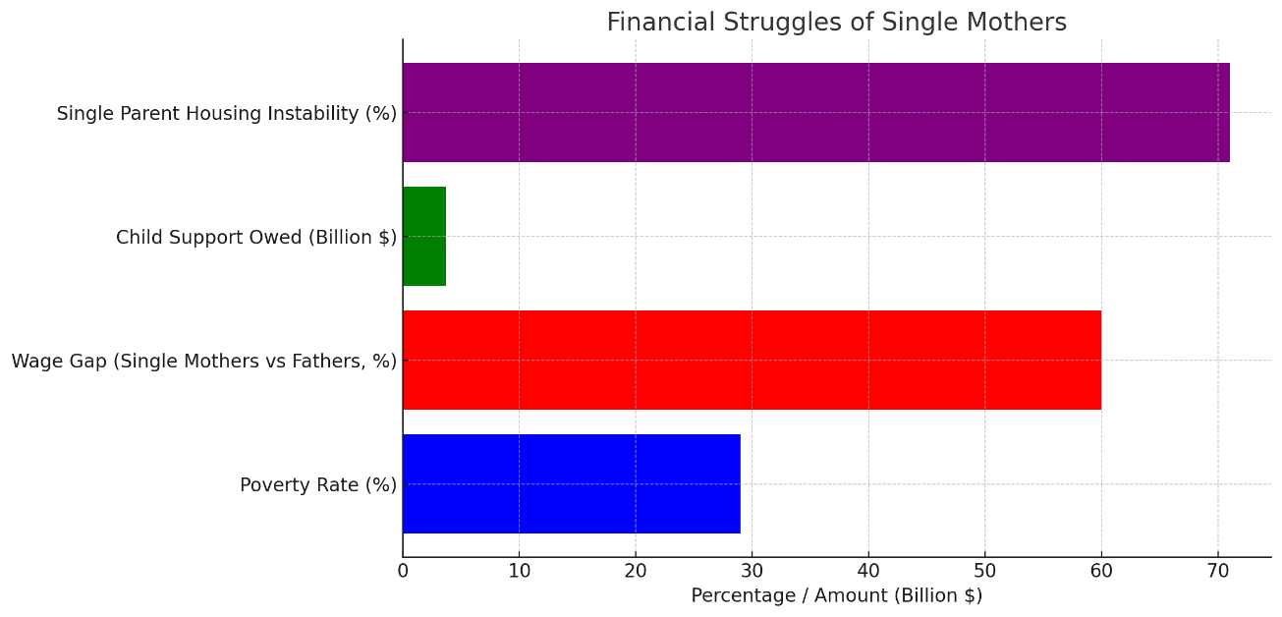
Financial struggles of single mothers
Single mothers often face unique financial challenges, including limited income, unexpected expenses, and the responsibilities of parenting. These pressures can make budgeting and financial planning difficult, leading to stress and uncertainty about their financial future.

Slide 5

Lack of budgeting tools tailored for single parents
Many budgeting tools are not designed with the specific needs of single parents in mind. These tools often overlook the complexities of managing finances while caring for children, leading to a gap in accessible and relevant financial support.

Slide 6
Solution Overview
The AI-Driven Budget Planner is a website that provides:
Dashboard: A centralized hub for financial overview.
Budget Planning: Tools to create and manage budgets.
Expense Tracking: Track and categorize expenses.
Chatbot: AI-powered assistant for personalized advice.
User Profile: Personalized settings and progress tracking.

Slide 7

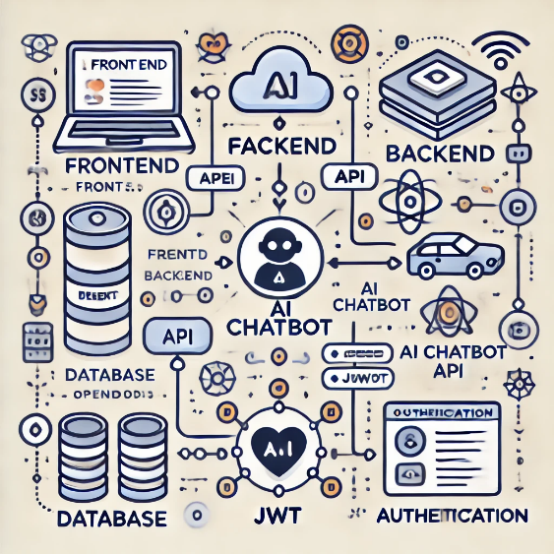


Tech Stack & Architecture
Frontend:
HTML, CSS, JavaScript
Frameworks: React.js for responsive design
Backend:
Node.js
Database: MongoDB
AI Integration:
OpenRouter API for the chatbot
API testing:
Postman
Architecture:
User interacts with the frontend.
Backend handles data processing and storage.
AI chatbot provides real-time advice.

Slide 8
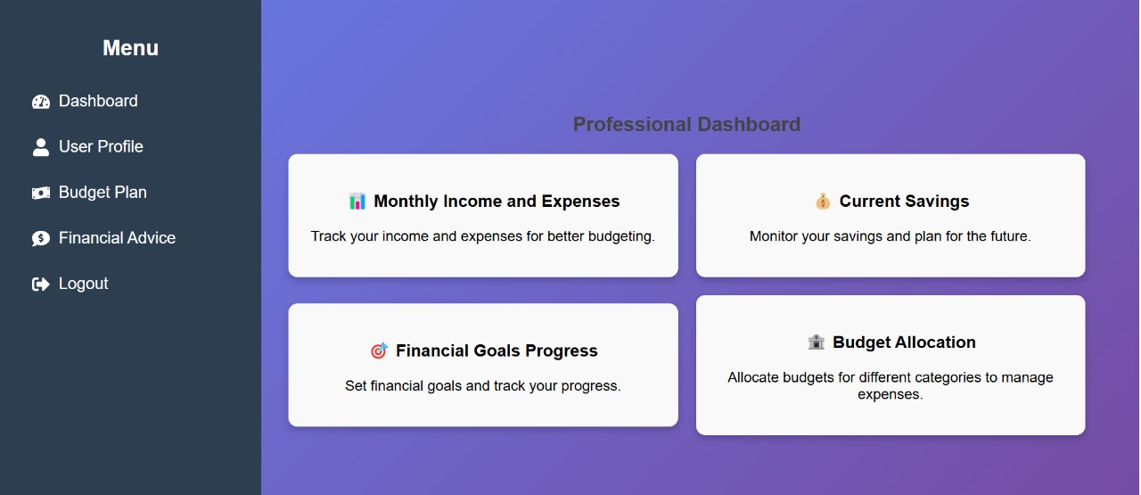
Features and Functionality
Dashboard:
Centralized hub for financial overview.
Monthly Income and Expenses:
Log and track monthly income sources (e.g., salary, freelance work).
Current Savings:
Track savings in real-time.
Financial Goal Progress:
Set short-term and long-term financial goals (e.g., saving for education, buying a car).
Budget Allocation:
Create customized budgets for different categories (e.g., groceries, entertainment, childcare).
Chatbot:
Predefined FAQs: Instant answers to common questions (e.g., "How can I save money on groceries?").
Custom Questions: Ask personalized questions for tailored advice.

Slide 9
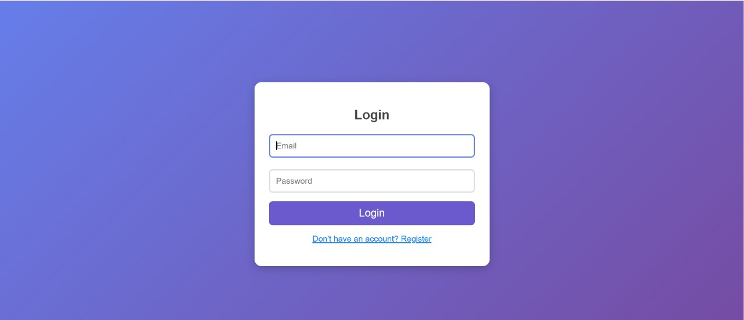
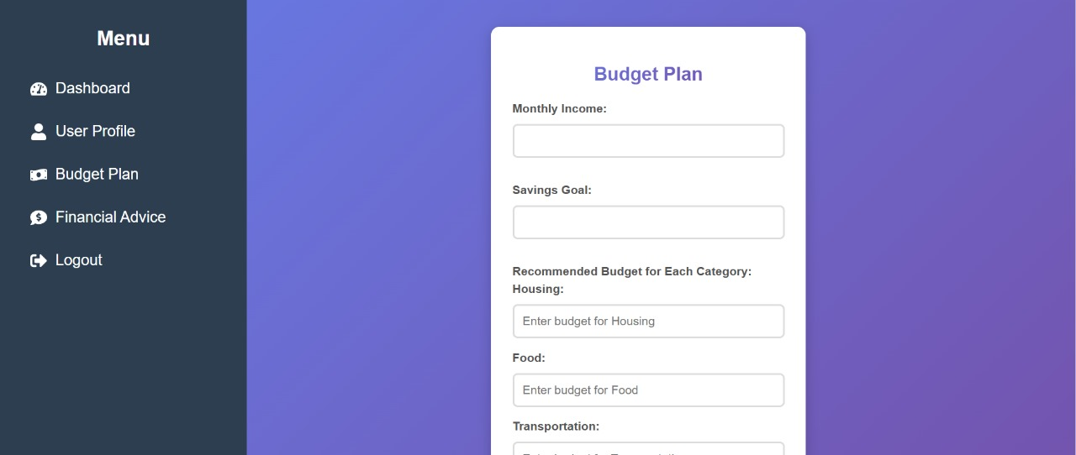
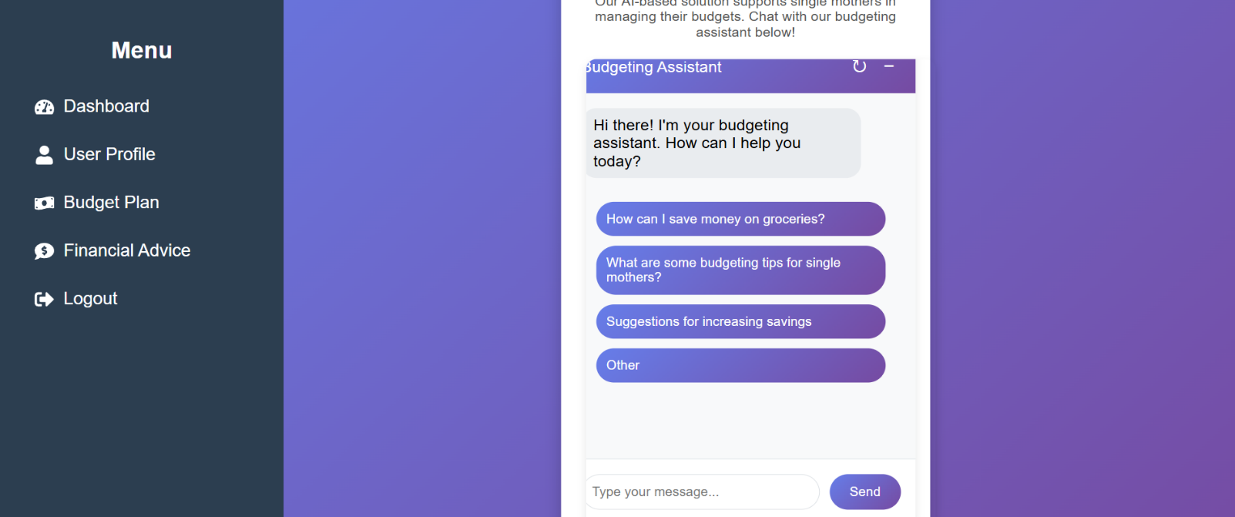
Budget planner
Login Page
AI chatbot

Slide 10
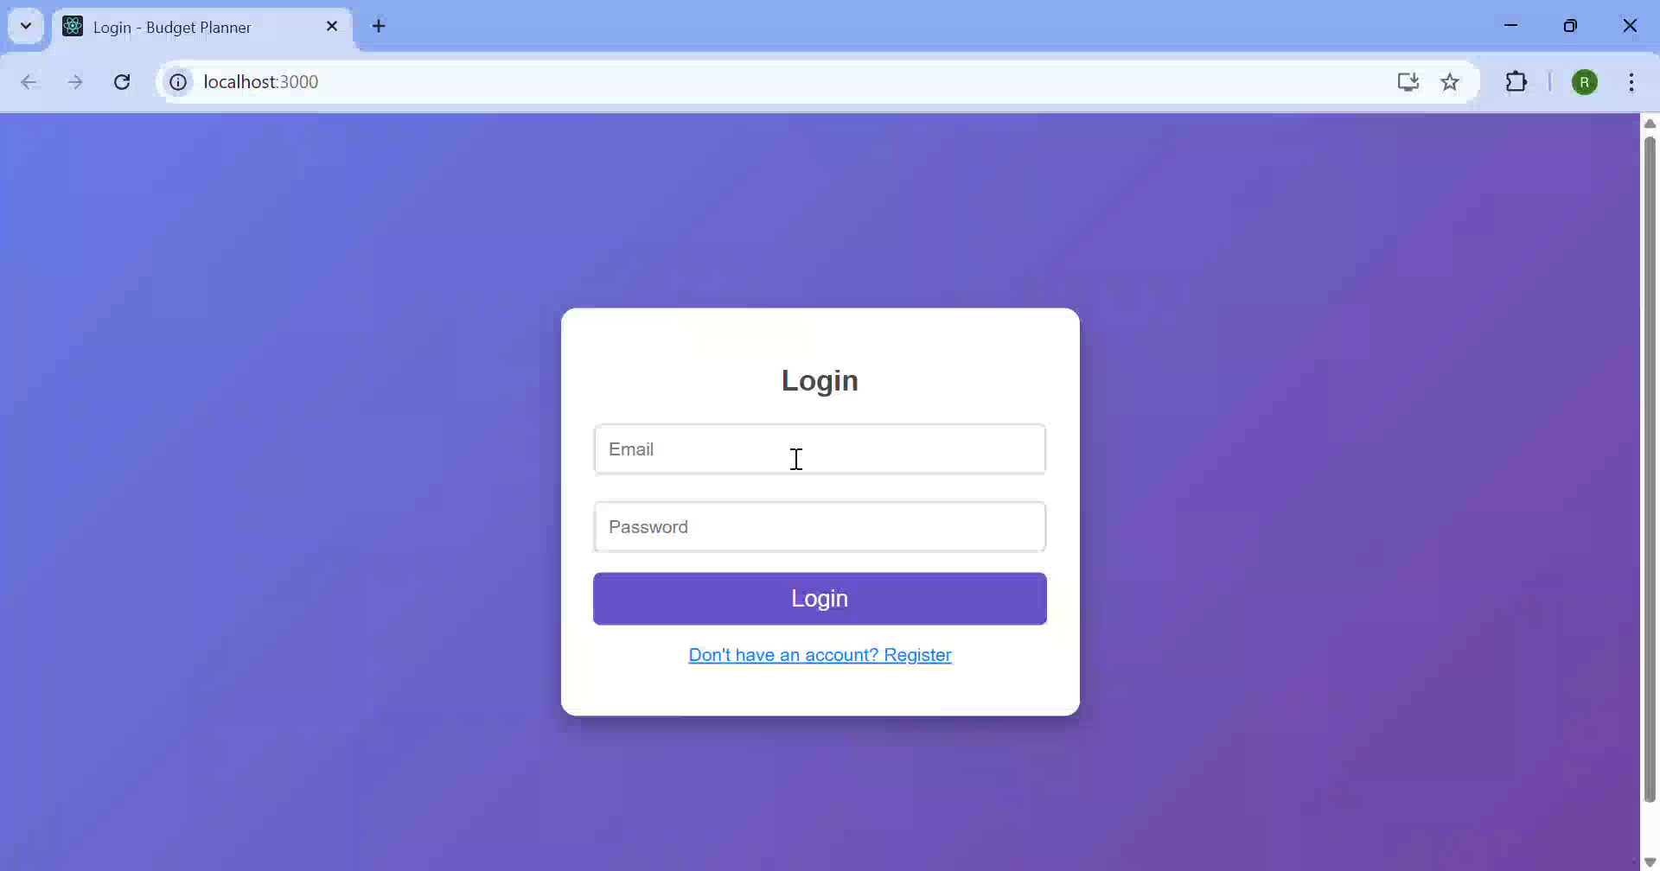

Slide 11

Future Scope
Integration with Banking APIs:
Automatically sync transactions for real-time expense tracking.
Multilingual Support:
Add support for multiple languages to reach a wider audience.
Mobile App:
Develop a mobile app for on-the-go access.
Resource Hub:
Provide links to government assistance programs, financial planning tools, and educational resources.
Advanced Analytics:
Use machine learning to provide predictive insights (e.g., future expenses, savings goals).

Slide 12

Conclusion
The AI-Driven Budget Planner is a comprehensive platform designed to empower single mothers with smart financial tools.
By combining a user-friendly interface with AI-powered insights, it simplifies budgeting, expense tracking, and financial planning.
Future enhancements will make it even more versatile and accessible.

Slide 13
Thank you!

